Slide 1
U.S.-China Librarian Collaboration Project 中美图书馆员专业交流項目
Evaluation of the First Library Continuing Education Program
Held in Beijing and Nanjing
May 18-23, 2009
Hwa-Wei Lee
Project Evaluator
leeh@ohio.edu

Slide 2
The beginning of a two-year pilot project
On May 18, 2009, at the National Library of China in Beijing, the first official program for U.S.-China Librarian Collaboration (中美图书馆员专业交流項目) was launched in a formal ceremony.
It was attended by officials from the Chinese Ministry of Culture, the National Library of China and the Library Society of China.

Slide 3
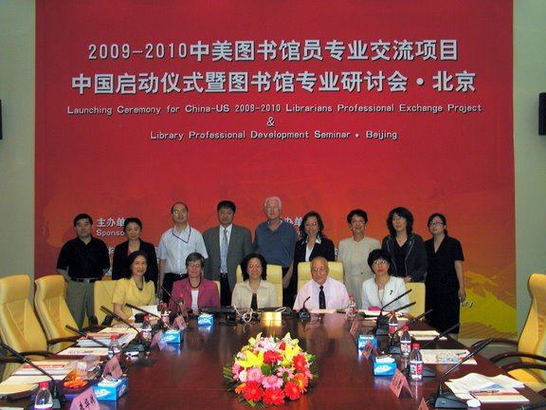
Chinese officials and members of the U.S. delegation

Slide 4
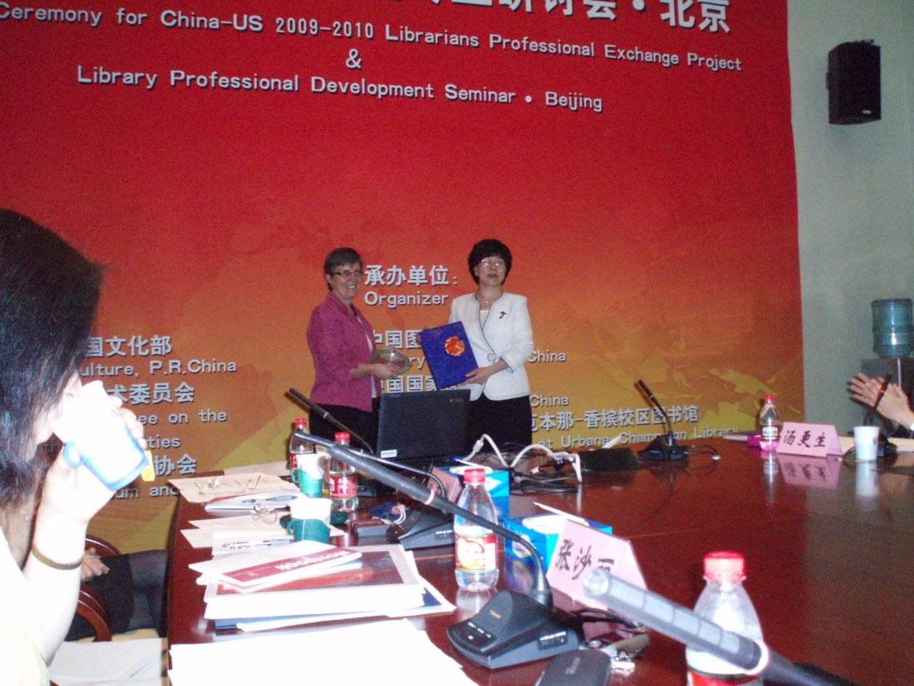
Exchange of gifts

Slide 5
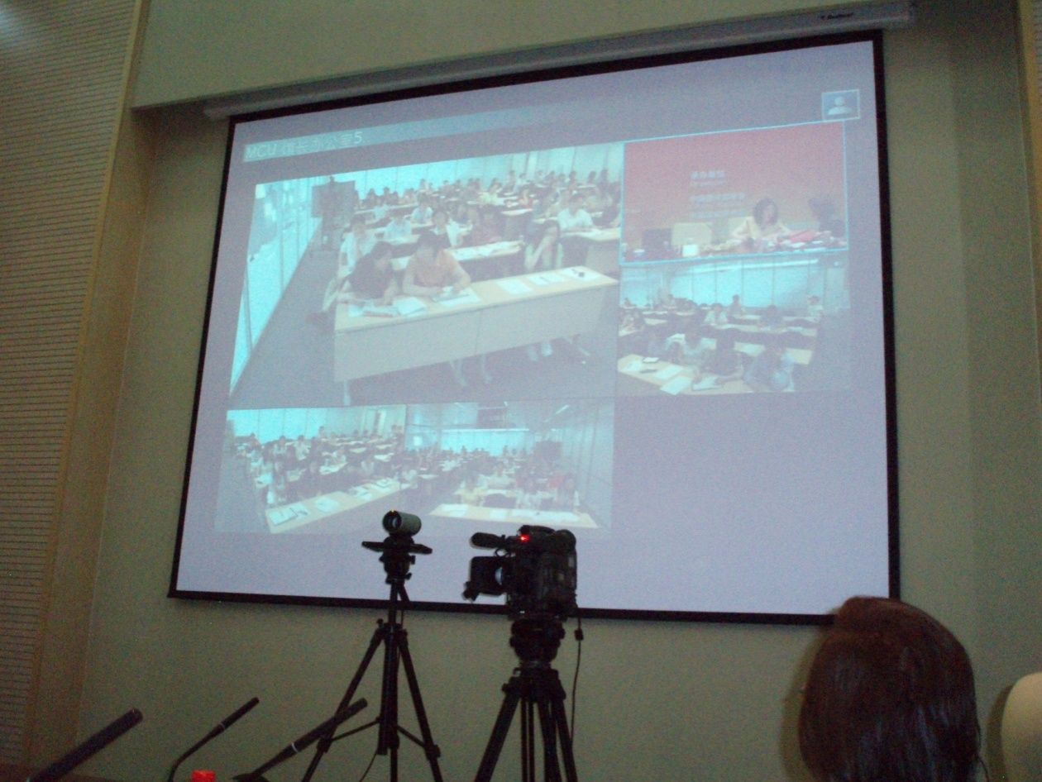
The program was broadcasted to six remote sites

Slide 6
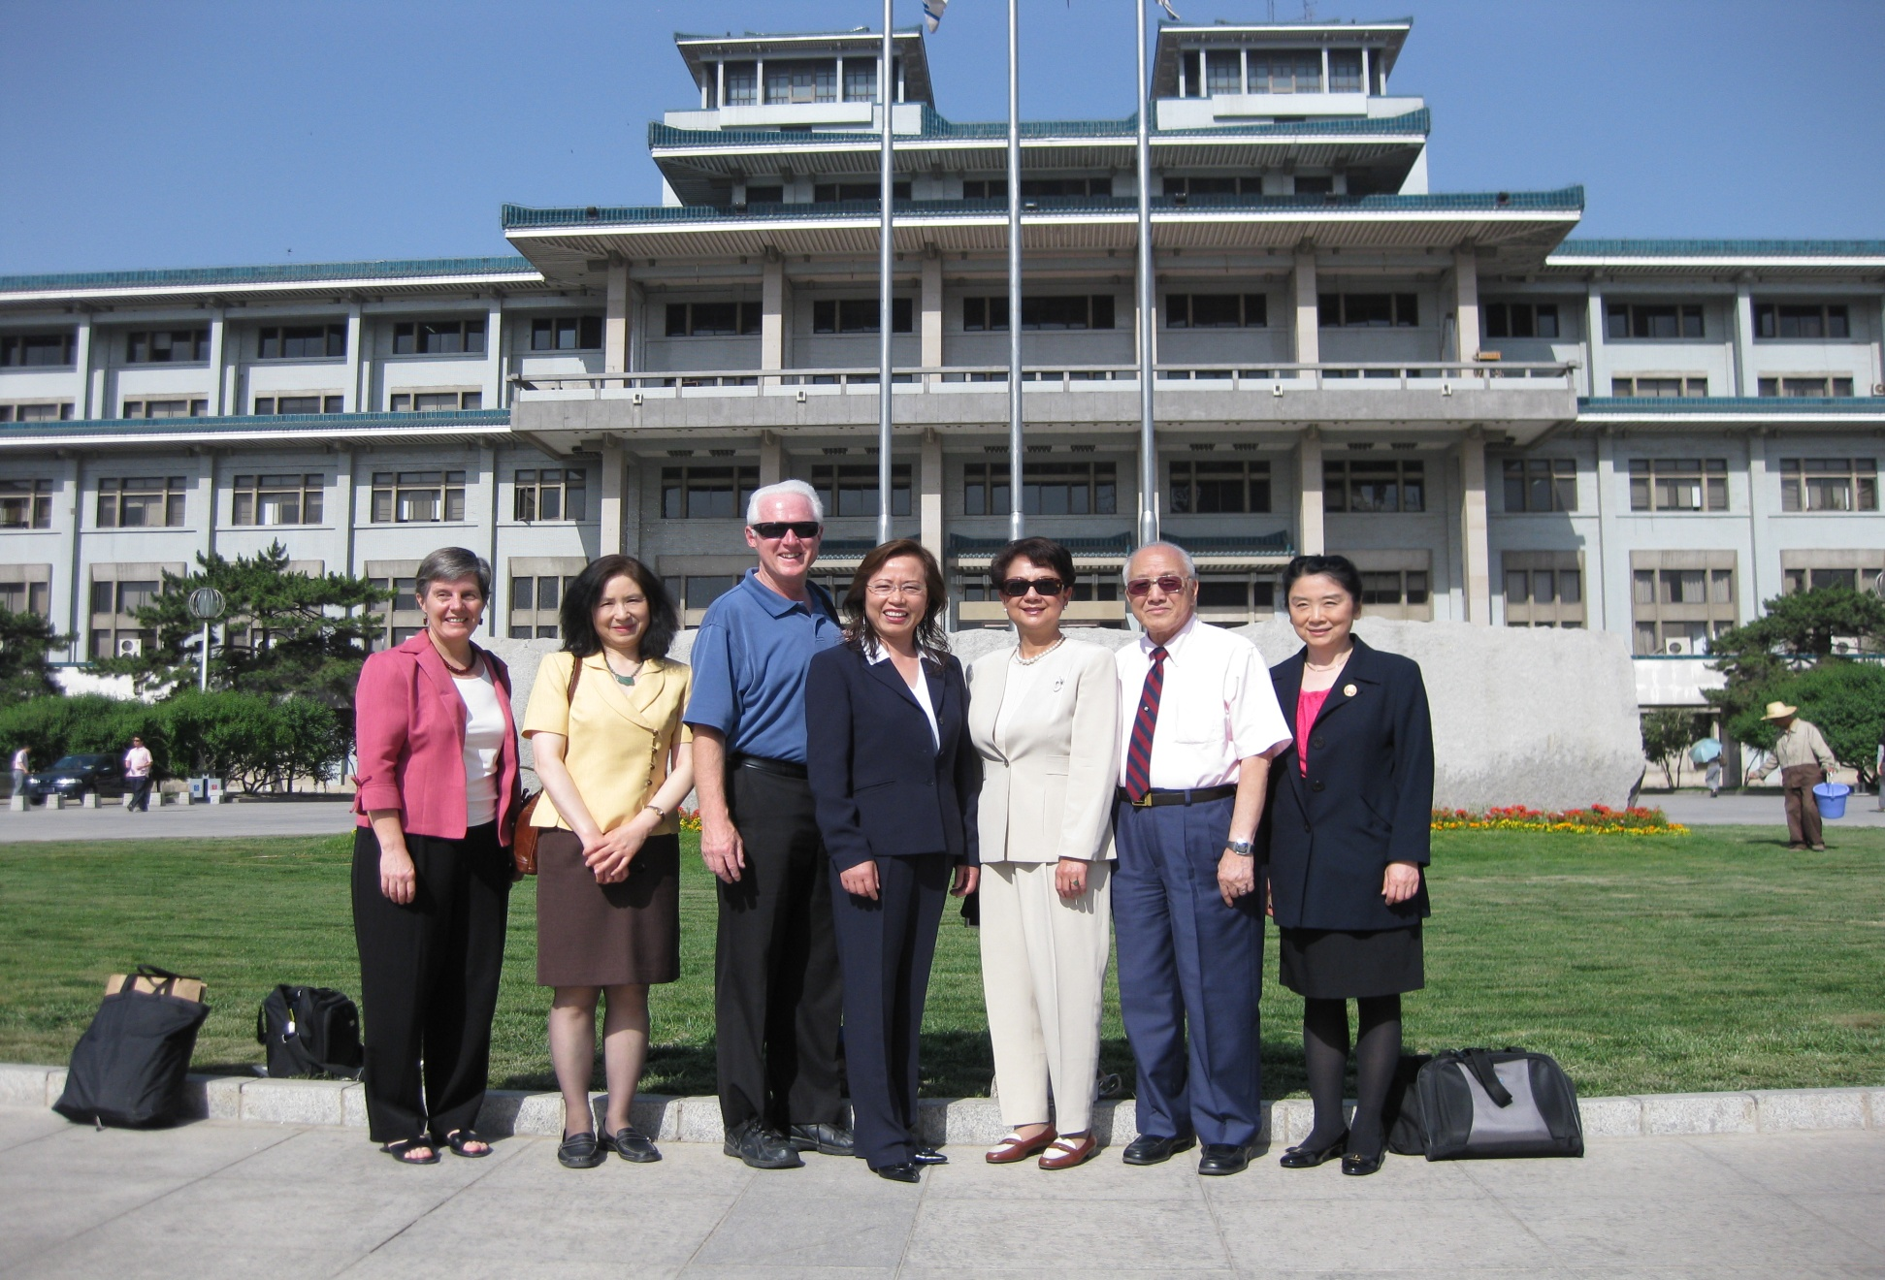
Members of the U.S. Delegation in front of NLC

Slide 7

The new library building of NLC

Slide 8
Two lectures were presented in Beijing
U.S. Public Libraries’ Administration and Operating Infrastructure (Sha Li Zhang and Susan Schnuer)
Library Assessment and Libraries Enrich Lives (Bob Fernekes and Lisa Zhao)

Slide 9
Six lectures were presented in Nanjing
American Library Administration and Operating Infrastructure (Sha Li Zhang and Susan Schnuer)
Libraries in Laws and Laws in Libraries – U.S. Experience in the Process of Legislation (Lisa Zhao)
Public Library Services in the U.S. (Mengxiong Liu)
Library Assessment and Professional Qualifications of Librarians in the U.S. (Bob Fernekes)
Public Relations and Outreach Activities of American Public Libraries (Wenwen Zhang)
Library Organizations for University Libraries, Special Libraries, and Library Education in the U.S. (Sha Li Zhang)

Slide 10
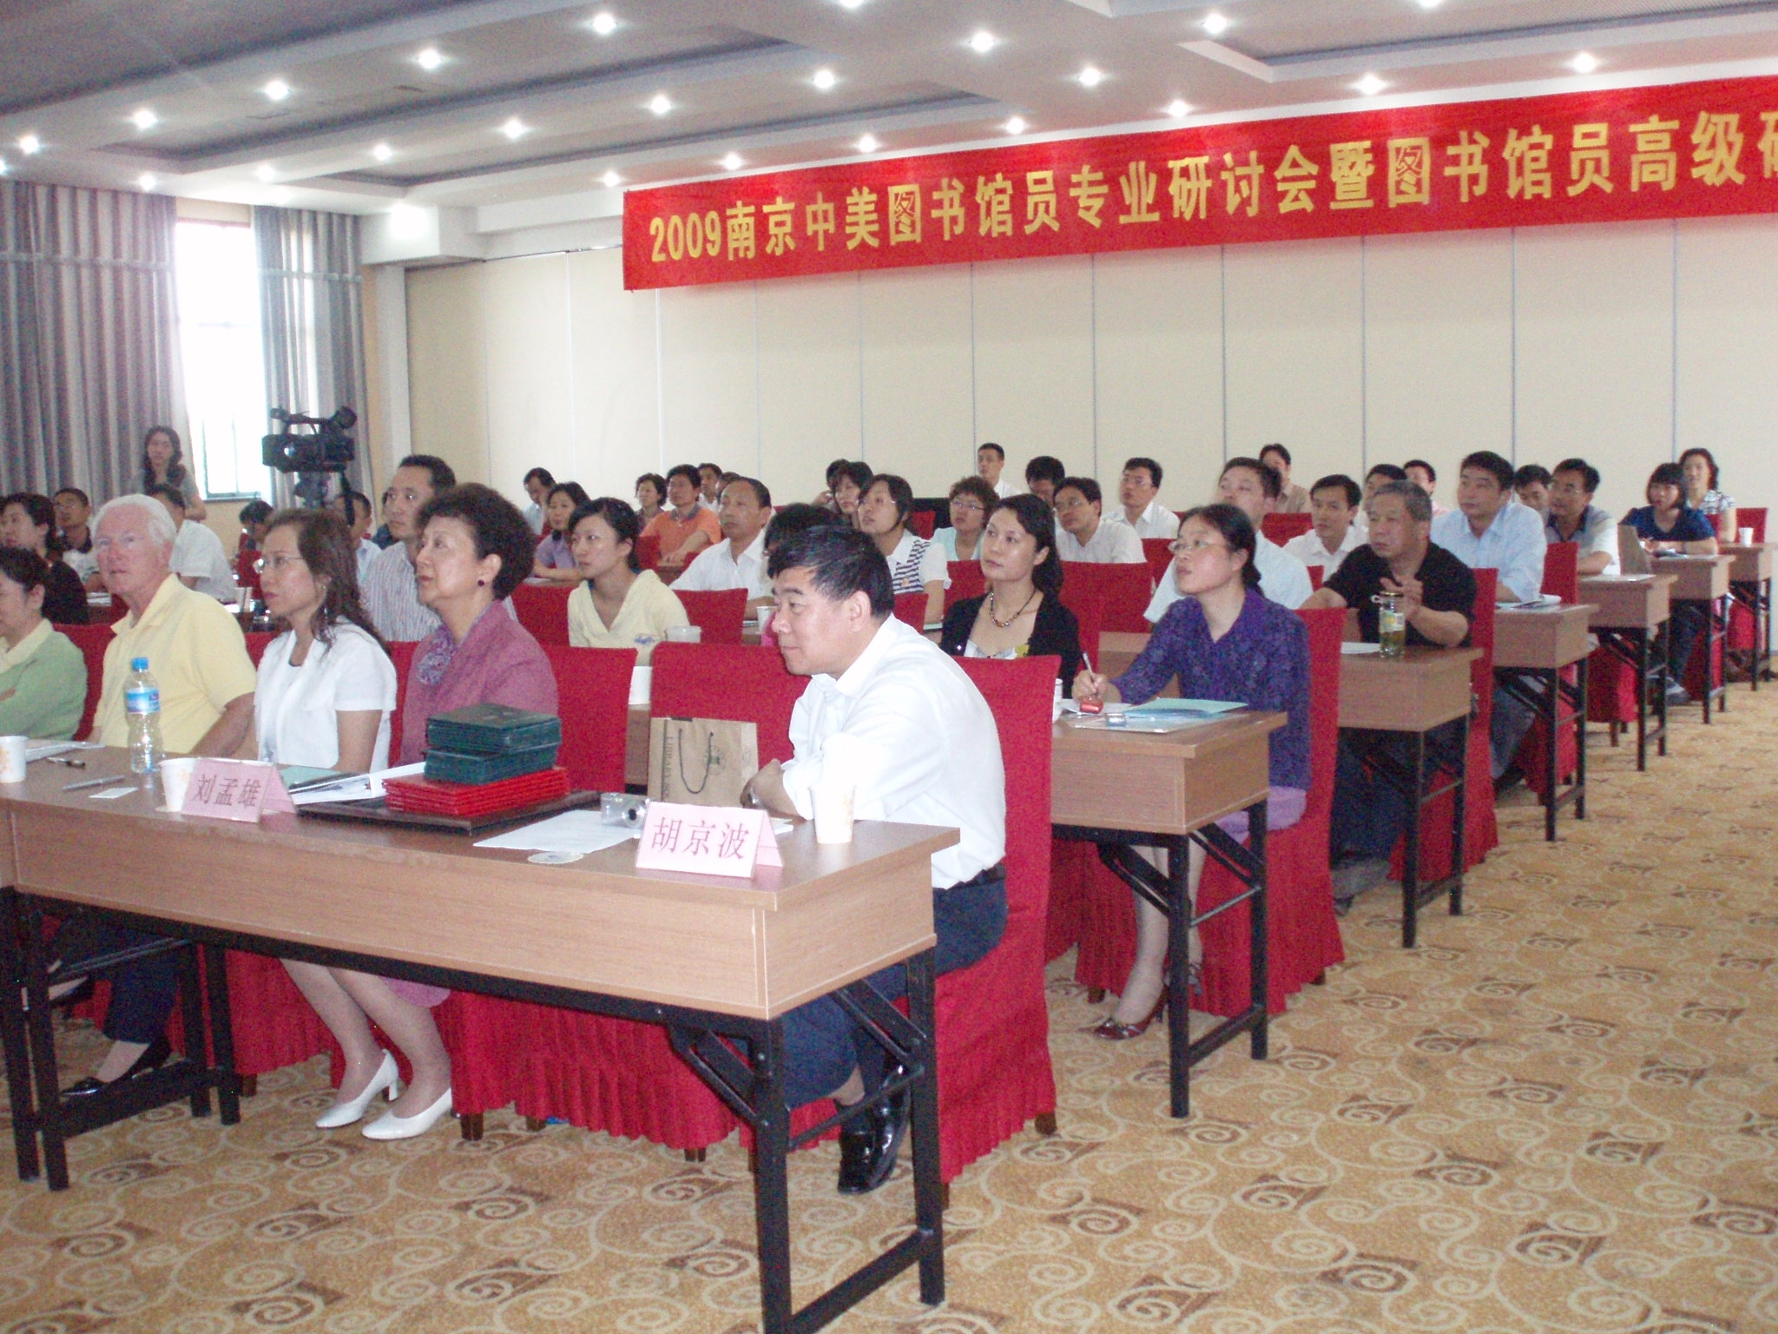
The Seminar in Nanjing

Slide 11
Program evaluation survey
Using a five-point rating system:
  5 as the most satisfactory
  4 as satisfactory
  3 as average
  2 as unsatisfactory
  1 as no opinion

Slide 12
Feedback from 35 Nanjing Participants
Survey Questions | 5 | 4 | 3 | 2 | 1
The overall design of the program | 10 | 22 | 3 | 0 | 0
The selection of all the lectures | 5 | 21 | 4 | 0 | 0
The selection of all speakers | 10 | 20 | 1 | 0 | 0
The way the lectures were delivered | 16 | 17 | 1 | 0 | 0
Interactions between speakers and participants | 19 | 13 | 2 | 0 | 0
Course and reference materials provided | 2 | 6 | 23 | 1 | 0
The facility where the program was held | 3 | 18 | 11 | 0 | 0
Other arrangements made for the program | 2 | 20 | 10 | 1 | 0
The usefulness of the program as a whole | 7 | 20 | 5 | 0 | 0

Slide 13
Feedback from US Team Members
Survey Questions | 5 | 4 | 3 | 2 | 1
The overall design of the program | 3 | 3 | 0 | 0 | 0
The general qualifications of the participants | 4 | 2 | 0 | 0 | 0
The general responses of the participants | 4 | 2 | 0 | 0 | 0
Interactions with the participants | 2 | 2 | 1 | 1 | 0
The general impression of the degree of success | 5 | 0 | 1 | 0 | 0
The facility where the program was held | 4 | 2 | 0 | 0 | 0
Other arrangements made for the program | 5 | 1 | 0 | 0 | 0

Slide 14
Comments & suggestions by participants
Have more in-depth discussion sessions and informal meetings with speakers. (10)
Have more of such programs to exchange experiences. (5)
Cover more current issues directly related to the interests and concerns of Chinese librarians. (5)
Provide more course and reference materials, including PPT printouts of lectures, at the beginning of the program. (5)

Slide 15
Comments & suggestions by participants
let more librarians participate in the program so that more can learn about the latest library practices in the U.S. (3)
Have different programs for public libraries and academic libraries enabling more librarians from both types of libraries to participate. (2)
All speakers are very knowledgeable in each of their areas of specialties. As a whole, they seemed to complement each other very well.

Slide 16
Comments & suggestions by participants
This program has been very helpful to me to gain a better understanding of the role of libraries in the 21st century in terms of their functions and services.
I want to thank both the Chinese and U.S. governments for providing such an opportunity.
I want to thank the seven American experts and their excellent presentations.

Slide 17
Outcome assessments by participants
We learned from the lectures many new concepts and practical approaches which can be used in improving reader services in our libraries. (13)
We can apply the following knowledge in our work – Readers-oriented Services, research of readers needs, interlibrary loan, in-service training for staff, fundraising, friends society, outreach and community relations, reader advising, volunteers, etc. (18)

Slide 18
Outcome assessments by participants
I am impressed by the idea that “Library Enriches Lives” and will apply it in my library. (5)
I want to apply library assessment in my library. (3)
The high standards for and varied library services in the U.S. can serve as our model in China. (3)
The program is very useful for Chinese librarians to make comparison of the librarianship and library practice between China and the U.S.

Slide 19
Outcome assessments by participants
I like the idea of building local specialties in library collections.
I will make more use of the “Humanization” concept of services and operations in my library.
I will use the American approach to seek more legislative support for libraries.
I will use the American model to improve my own qualifications and management abilities.

Slide 20
Outcome assessments by participants
I like the idea of having a “Forgiveness Day” occasionally so that my library can get many books back from delinquent borrowers.
I am greatly impressed by the rich professional knowledge, extensive working experiences, and strong dedication and work ethics of American experts and will follow their examples in my library work. (2)

Slide 21
Conclusion and recommendations
The selection of team members
Working out the schedule
The pre-trip orientation
Learning more about the current status of Chinese libraries
Be flexible about unexpected changes
Better prepared handouts
More discussion time
Building bridges

